Slide 1
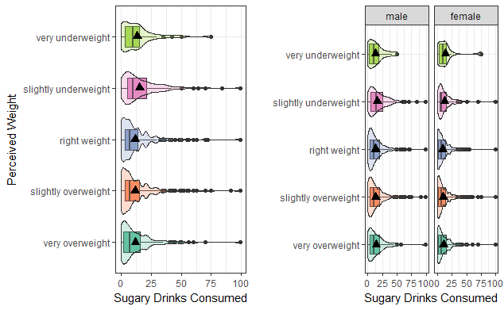
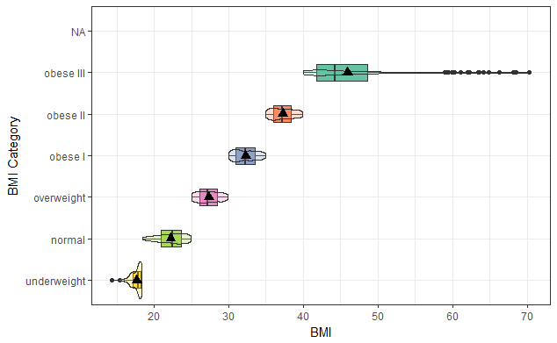
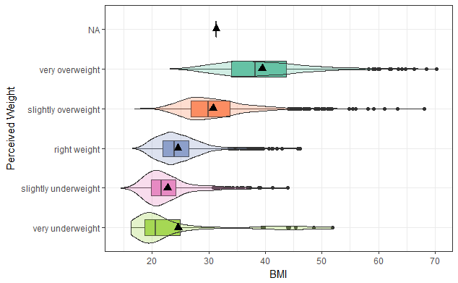
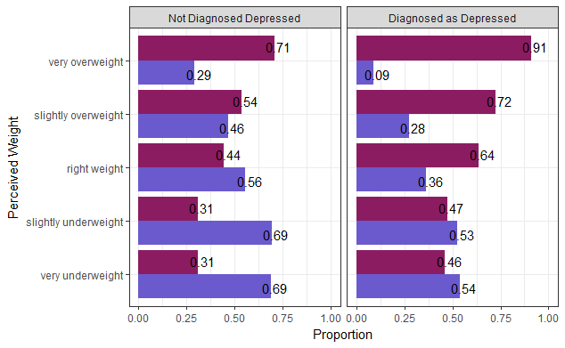
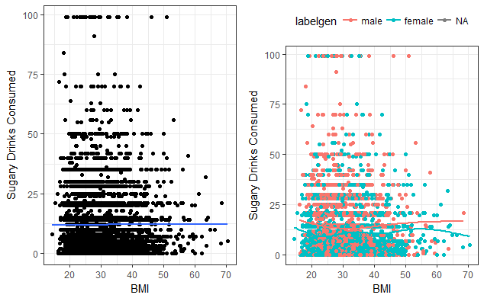
Exploring the link between body image and depression: does negative body image lead to poor mental health or an increase in sugar consumption?
Megan Luke
Introduction
Demographics
Results
Results
While the association between depression and body image has been studied rather extensively, little research has been conducted which fully explore whether the negative feedback loops created by depressive thoughts actually lead to poor dietary choices. If this is true, then poor body image could lead to depression, which could then lead to poor dietary choices which cause health problems like obesity to be more likely.
The sample used for this study is a section of the Add Health Wave IV survey. The original sample size is 6503 individuals who had participated in the Wave I survey several years prior. The sample was random, and included a range of ethnicities. The sample surveyed is 48% male and 52% female. For analysis on participants who responded to questions regarding perceived health, feelings of depression, sugary beverage consumption and body mass index the sample size was 822 individuals.
“Wave IV was designed to study the developmental and health trajectories across the life course of adolescence into young adulthood. In Wave IV, biological data was also gathered in an attempt to acquire a greater understanding of pre-disease pathways, with a specific focus on obesity, stress, and health risk behavior. At the same time that the Add Health cohort was assuming adult roles and responsibilities, they were also developing crucial health habits and lifestyle choices that set pathways for their future adult health and well-being. The Wave IV Component was designed as a follow-up of the nationally representative sample of adolescents first interviewed in 1995. At Wave IV, the comprehensive personal interview also included physical measurements and biospecimen collection.” -Add Health Wave IV Codebook
Figure 2.
Perceived Weight and Sugary Drinks Consumed, Controlled for Gender
After controlling for gender, people who have been diagnosed as depressed have 1.37 times the odds of considering themselves to be over or underweight compared to someone who has not been diagnosed as depressed. After controlling for depression diagnosis, females have 1.5 times the odds of considering themselves to be under or overweight compared to males. Gender is a slightly stronger predictor of whether a person will consider themselves under or overweight than a diagnosis of depression.
After adjusting for the potential confounding factor of gender, being diagnosed with depression (1.37, CI 1.15-1.61, p <.0003) was significantly and positively associated with the likelihood of a person considering themself to be under or overweight. In this analysis, the odds ratio tells us that those who have been diagnosed as depressed are 1.37 times more likely to consider themselves to be under or overweight. Based on these analyses, gender is not a confounding factor because the association between diagnosis with depression and considering themselves to be under or overweight is still significant after accounting for gender.
Discussion
Background
Methods of Analysis
The graphical and inferential results of my research shows that there is a statistically significant relationship between the number of sugary beverages consumed by a person and their perceived weight (p=0.001). Gender has significant influence on the strength of relationships between sugary beverage consumption, perceived weight and frequency of feeling depressed, especially when looking at a person’s actual BMI and not just their perception of their weight. My hypothesis was that there was a relationship between a person’s perceived weight, frequency of feeling depressed and consumption of sugary beverages. My research has shown that these variables do in fact have correlations of varying degrees of significance. In general, my research has shown that women have a higher likelihood of feeling depressed than men(p=0.0001). The relationship between sugary beverage consumption and BMI is significant for women (p=0.01), but not for men.
I will be revising this section
This study used data from the Add Health Wave IV research survey to compare and contrast the responses to survey questions with actual body measurements taken at the time of the survey. The goal was to determine whether people who perceive themselves as overweight and underweight are more prone to feelings of depression or to consumption of more sugary beverages. These results were then controlled for gender.
Poor body image has been linked to depression in several papers. Richard, A., Rohrmann, S., Lohse T., and Eichholzer, M. found a strong correlation between body image dissatisfaction and feelings of depression in a large cross-sectional study in 2016. Low-self esteem and poor body image were found to be linked to depression and poor health choices in another paper (Rawana, J., & Morgan A., 2014). Sugary drink consumption will be used as a measure of poor dietary choices due to many studies linking them to obesity and depression (Pollard et al., 2016; Henriksen, R., Torsheim, T., Thuen, F., 2014).
The research question being explored in this study is whether people’s body image is associated with the person’s feelings of depression and diagnosis of depression, and number of sugary drinks being consumed. The goal was to explore if there is a relationship between body image, consumption of sugary beverages and feelings of depression. Gender was considered to be a potential important variable in these relationships and was controlled for.
In order to determine the meaning of “perceived weight” categorical comparison to actual body mass index (BMI) was conducted. This comparison showed that there was a much broader range of weights within the perceived categories as illustrated by Figure 1.
There is sufficient evidence to conclude that the average number of sugary drinks consumed each week is associated with a person's perceived body weight (p<.001). Specifically the number of drinks consumed by a person who considers themselves the right weight is significantly different than a person who is slightly underweight (p=0.00004), the number of drinks consumed by a person who is slightly overweight is significantly different from the number consumed by a person who is slightly underweight(p=0.00001), and the number of drinks consumed by a person who is very overweight is significantly different than the number consumed by a person who is slightly underweight (p=0.001). ANOVA analysis and a Tukey HSD ad-hoc test were used.
It seems that in general, males consume more sugary drinks than females, regardless of perceived health. Males who consider themselves slightly underweight and very overweight consume the most sugary beverages on average (16.5 and 14.6 in a seven day period, respectively). Females who consider themselves very underweight or slightly underweight consume the most sugary beverages on average (14.0 and 12.6 in a seven day period, respectively).
The original ANOVA and the stratified ANOVA models for males and females separately are significant. There seems to be a difference in the relationship between number of sugary drinks consumed in the past seven days and perceived weight between males and females, so gender is a moderating variable for this relationship. The relationship between perceived weight and number of sugary beverages consumed was significant in the original model (p <0.0001). When controlled for gender this significance changed and became less significant (p = 0.01 for males and females.) This is a type 3 scenario.
Figure 1.
Actual body mass index compared to medically established categories
Actual body mass index compared to perceived weight category of individual
Implications
The practical implications of my research are that the amount of sugary beverages consumed by a person and their body image (specifically their perceived weight) may be strong indicators of a person’s mental health or tendency towards depression. Knowing these early indicators may assist in providing support to at-risk individuals. This seems to be especially true for women.
Future research would involve determining if there are other factors involved in a person’s mental or physical health that are influencing sugary drink consumption. More research could be done on how close a person’s perception of their weight was to the reality of their weight. Additional research could be done on groups only including women to see if sugary beverage consumption and perception of weight actually did indicate depression, and it would be important to find a way to score or create a standard curve for that comparison.
Once an understanding of the variables had been established, various statistical analysis were performed on the data using Rstudio software. Graphics were generated to allow clear representation of data and statistical output was translated to provide meaningful results.
Results
Figure 1.
Perceived Weight and Gender, Controlled for a Diagnosis With Depression
Figure 3.
BMI and Sugary Drinks Consumed, Controlled for Gender
References
Henriksen,R. E., Torsheim, T., Thuen, F. (2014) Loneliness, social integration and consumption of sugar-containing beverages: Testing the social baseline theory. PLoS ONE, 9(8). https://doi.org/10.1371/journal.pone.0104421.
Pollard, C. M., Meng, X., Hendrie, G. A., Hendrie, D., Sullivan, D., Pratt, I. S., … Scott. J. A. (2016) Obesity, socio-demographic and attitudinal factors associated with sugar-sweetened beverage consumption: Australian evidence. AUS and NZ J of Public Health, 40(1)71-77. DOI: 10.1111/1753-6405.12482.
Rawana, J. S. and Morgan A. S. (2014). Trajectories of depressive symptoms from adolescence to young adulthood: The role of self-esteem and body-related predictors. Journal of Youth and Adolescence, 43,597-611. DOI 10.1007/s10964-013-9995-4.
Richard, A., Rohrmann, S., Lohse T., and Eichholzer, M. (2016). Is body weight dissatisfaction a predictor of depression independent of body mass index, sex and age? Results of a cross-sectional study. BMC Public Health, volume 16 number (863). DOI 10.1186/s12889-016-3497-8.
We can conclude that there is an association between gender and frequency of feeling depressed (X2 = 22.8, df=4, p=.0001). The proportion of females significantly differs between some pairs of frequency groups, the Never/Rarely and Sometimes (52% vs 56% female), Never/Rarely vs. A lot of the Time (52% vs 64% female), and Never/Rarely vs. Most/All of the Time (52% vs. 67% female). A Chi-Square test of association was used along with ad-hoc analysis.
The relationship between gender and perceived weight is significant in both the main effects and the stratified model. The distribution of females across perceived weight categories differs between those with a diagnosis of depression and those without. A diagnosis with depression is not a significant moderator.
There is a weak or negligible relationship between BMI and number of sugary drinks consumed in the past week. While the correlation is stronger for females (0.05) than for males (-0.01), both of these values are too weak to be considered significant.
For males, there is little to no relationship between BMI and sugary drink consumption (p=0.06). For females the relationship is significant with a p-value of 0.01. This is Scenario 2, so BMI has a slight influence on sugary drink consumption for females only. Gender is a moderator for the relationship between BMI and sugary drink consumption.

